Slide 1
Impact-based Forecasting
African Regional Training on Severe Weather Forecasting and Warning Service – Workshop on Public Weather Services
Pretoria, 16th -20th November 2015

Slide 2
Two case studies from the UK

Slide 3
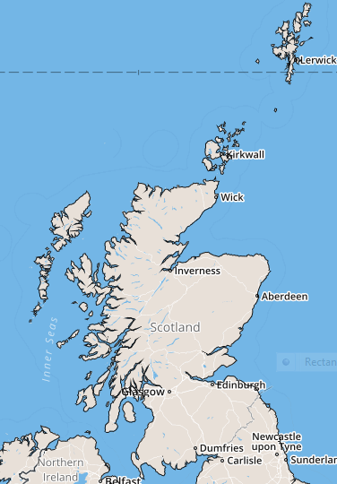
Scotland

Slide 4
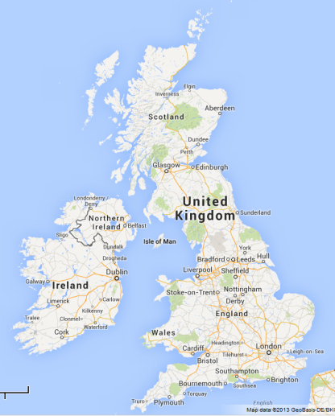
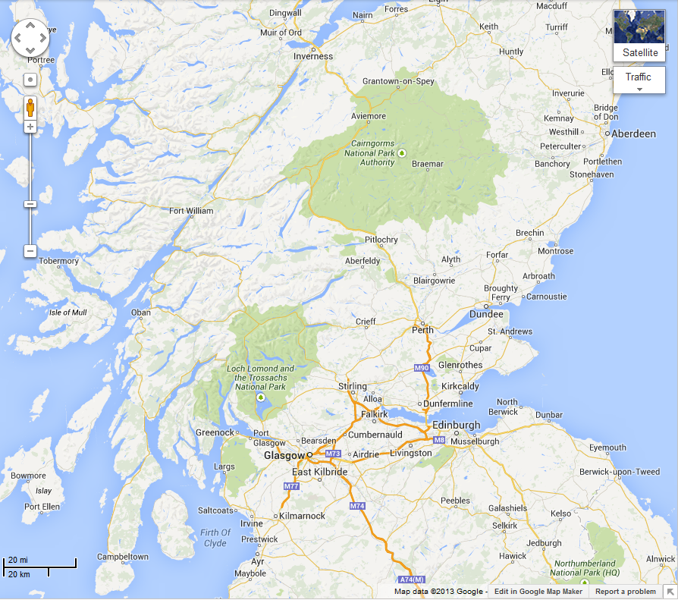
Scotland
Most of Scotland’s 5 million people live in this area – the “Central Belt”

Slide 5
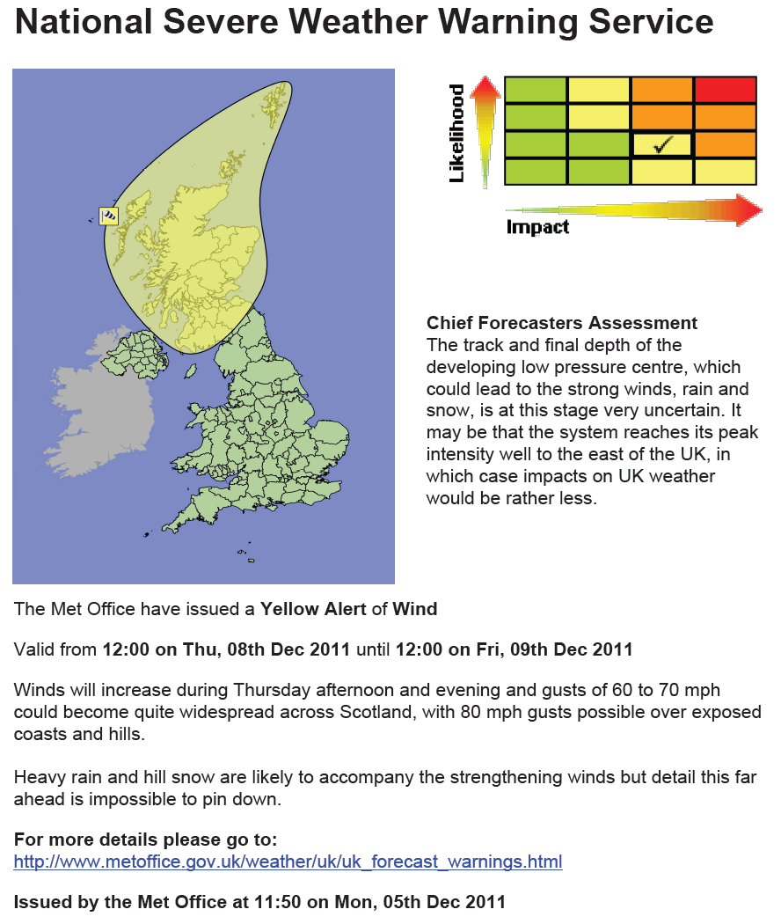
5th December 2011
First indications of a deep depression
Potential for winds to 60-70 mph, possibly 80 mph
Significant impacts possible
Uncertainties in where the strongest winds will be (Possibly offshore)

Slide 6
6th December
Warning updated in the morning but later in the day…
Situation looks even more serious
Advisor contacted key contacts in Scotland during evening of Tues 6th highlighting potential for winds in excess of 85mph through the Central Belt on Thu 8th

Slide 7
7th December
Scottish Government convene emergency committee (SGoRR) at 10am
Advisor briefs on potential for 80-90 mph winds through central belt
Information from police and transport agency indicated main bridges were likely to close completely at the forecast wind speeds, creating the risk of gridlock in important parts of the motorway network.

Slide 8
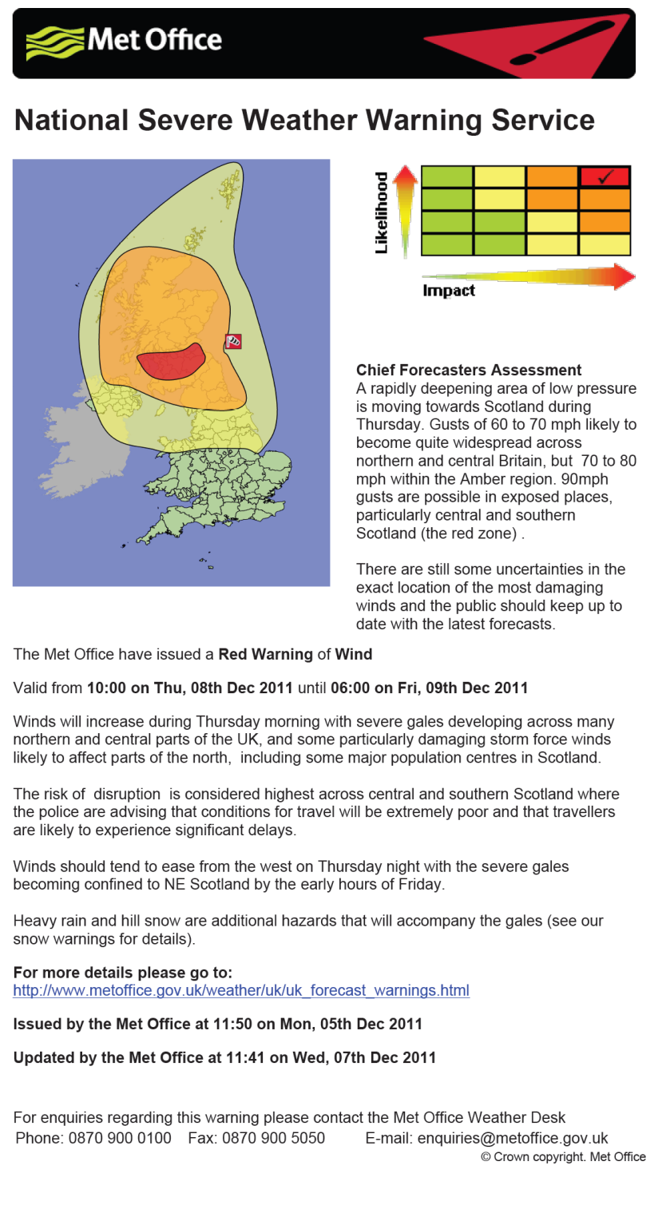
7th December 2011
Met Office now feel the likelihood of the event is HIGH
Information from partners indicate impact will be HIGH
RED warning issued at 24 hours in advance of event
Messages sent by the advisors to responders across Scotland

Slide 9
Actions Taken
Messages from advisors to emergency responders throughout Scotland highlighted potential for widespread transport and power supply disruption and structural damage with gusts of the expected magnitude.
Telephone calls made to Police contacts in advance of RED warning being issued.
Met Office Advisor deployed to Transport Scotland Multi-Agency Response Team (MART) at Control Centre (8th & 9th)
Advisor briefed Scottish Government officials and ministers before and during the event.
Scottish ministers “advised” closure of schools on the 8th.
Police advised people not to travel

Slide 10
What happened?
Wind speeds of 80-100 mph recorded through the Central Belt
Widespread travel disruption, power cuts and school closures across Scotland.
All main bridges were, indeed, closed
Speed restrictions on railways due to the risk of trees and other debris on rail lines.
Ferry services were delayed and some flights were cancelled.
Estimated 150,000 homes without power
Many trees were brought down, west-facing coasts were battered by very heavy seas and there was some building damage.
Localised flooding in northern England too.

Slide 11
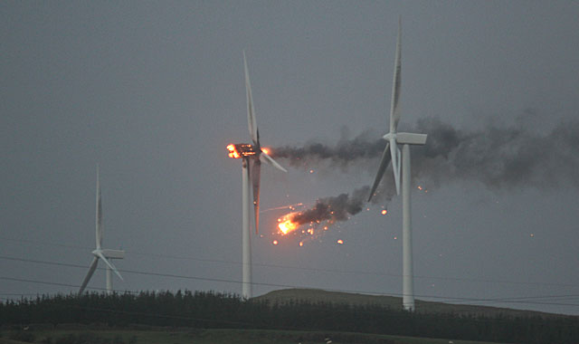
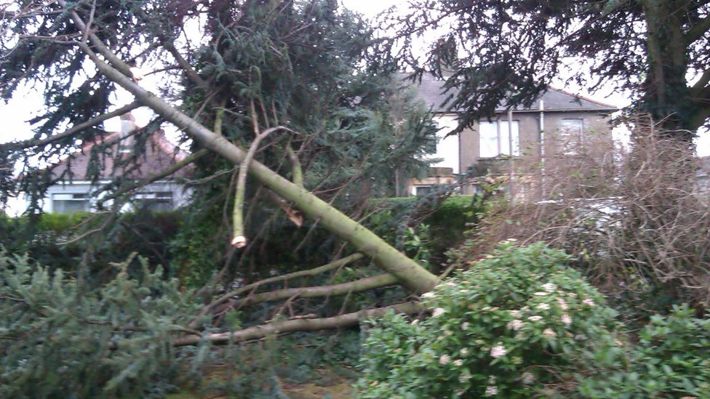
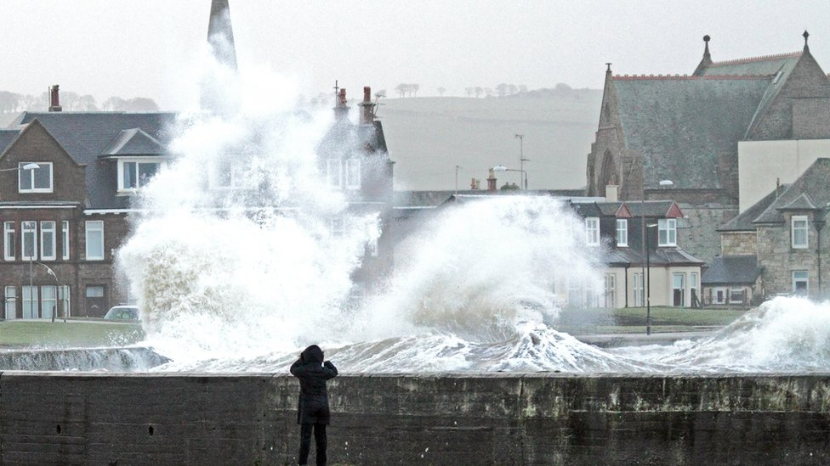
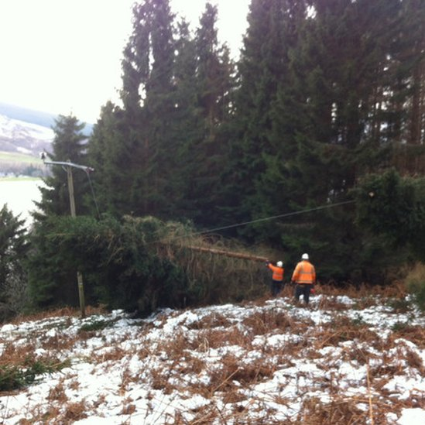
8th December 2011
Ayrshire
Edinburgh
Troon
Argyll
Notes:
Pics of some of the scenes during the storm of 8th December

Slide 12
November 12th/13th 2015
On Tuesday 10th
Severe gales signalled over the NW of Scotland, Western Isles, Northern Isles – up to 80 mph
Resilient to strong winds but work with local responders suggested
Very low likelihood of medium impacts (YLO)
On Wednesday 11th
Stronger signal for the main area and also risk of strong winds further south
Medium likelihood of medium impacts (AMB) - with low likelihood of medium impacts (YLO) expanded area

Slide 13
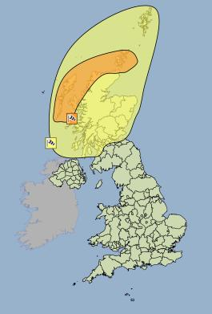
Wed 11th
Notes:
The Met Office have issued an Amber Warning of Wind
Valid from 21:00 on Thu, 12th Nov 2015 until 12:00 on Fri, 13th Nov 2015
Southwesterly severe gales will develop later on Thursday, increasing storm force for a
time as they veer westerly overnight into early Friday. Gusts of 70 to 80 mph are likely, and
perhaps 90 mph across exposed locations. Winds will begin to ease and veer more
westerly across the Western Isles and the mainland on Friday morning and across the
Northern Isles on Friday afternoon.
Lighting associated with frequent showers will be an additional hazard, whilst large waves
may lead to over-topping along some coasts and causeways.
The public should be prepared for disruption to transport and perhaps power supplies.
The Met Office have issued a Yellow Warning of Wind
Valid from 18:00 on Thu, 12th Nov 2015 until 14:00 on Fri, 13th Nov 2015
Southwesterly severe gales are likely to develop across the north and west of Scotland
later on Thursday and then extend across eastern areas and the Northern Isles into Friday
morning. Gusts of 60-70 mph are likely with the possibility of gusts to 80-90 mph in
exposed locations across the north and west of the area. Winds will begin to ease and veer
more westerly across the Western Isles and the mainland on Friday morning and across
the Northern Isles on Friday afternoon.
Lightning associated with frequent showers will be an additional hazard over northern and
western areas
The public should be aware of the risk of disruption to transport. In addition, large waves
may give rise to local over-topping along some coasts.
This is an update to the alert originally issued on Tuesday to extend the yellow area further
south and east, and also to escalate the likelihood of impacts in the risk matrix.

Slide 14
Advisors actions
  Daily email to all emergency responders in the area giving more context
  Contact key transport and government colleagues
  Take part in regional teleconferences as responders prepare for the event
Media
  Met Office Press Office ensures broadcast partners are aware and have the correct story
  Much done on social media, tweets etc
  Storm “Abigail”

Slide 15
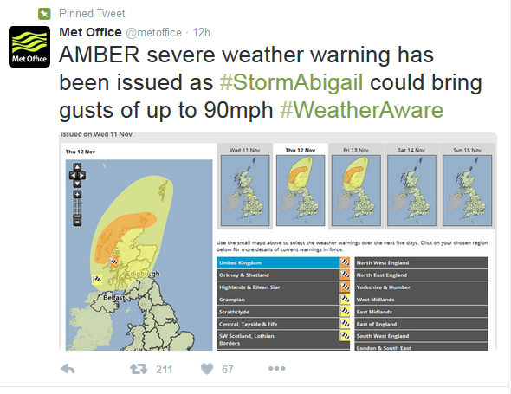
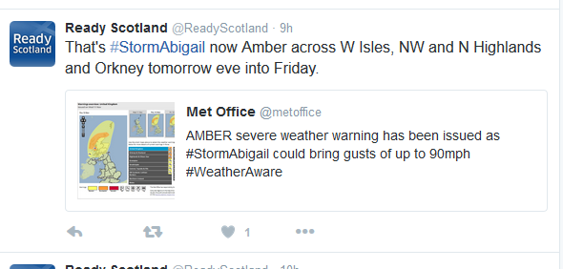
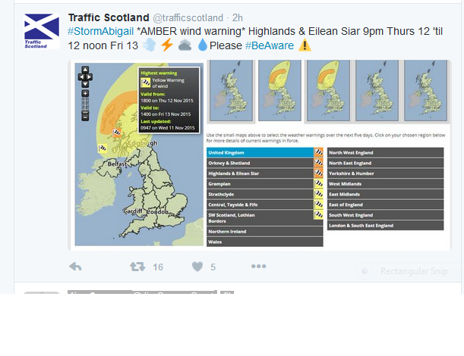
We tweet, partners re-tweet

Slide 16
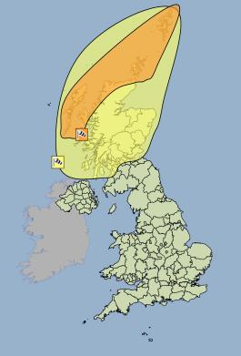
Thurs 12th – Final issue
  Amber area extended to include Shetland
  Yellow area remained much the same - Central Belt still included.

Slide 17
Impacts
  Power cuts
  Serious disruption to ferry services
  Schools closed in Western Isles (pre-emptive action)
  Did we over-estimate the impact level?

